Slide 1
Java Course
Justin Simon

Slide 2
Java is a programming language
object-oriented and secure programming language

Slide 3
Java was developed by Sun Microsystems(Now oracle) in 1995
James Gosling is known as the father of Java
Oak was the original name given later changed to java

Slide 4
Platform
Any hardware or software environment in which a program runs, is known as a platform
Java has a runtime environment (JRE) and API(Application Program interface) it is called a platform

Slide 5
Application
Web
Desktop
Mobile
Embedded
Robotics

Slide 6
Types of Application
Standalone Application
Web Application
Enterprise Application
Mobile Application

Slide 7
The current stable release of Java is Java SE 10

Slide 8
Features
Object Oriented
Platform independent
Multithreaded
Secured

Slide 9
Different from Other Technology
Java is compiled into bytecode which can run on any device with the Java Virtual Machine (JVM)
C++ is compiled directly into machine code and therefore, can only run on the same platform in which it was compiled

Slide 10
Platform Independent
Java is a write once, run anywhere language
Java provides a software-based platform.
Runs on top of other hardware-based platforms.
It has two components:
Runtime Environment
API(Application Programming Interface)

Slide 11
Flow of Java programe
Java compiler converts the source code into byte code.
Java code
Bytecode
Compiler
.java
.class

Slide 12
class keyword is used to declare a class in Java.
public keyword is an access modifier that represents visibility. It means it is visible to all
static is a keyword. If we declare any method as static, it is known as the static method. The core advantage of the static method is that there is no need to create an object to invoke the static method. The main() method is executed by the JVM, so it doesn't require creating an object to invoke the main() method. So, it saves memory
void is the return type of the method. It means it doesn't return any value
main represents the starting point of the program
String[] args or String args[] is used for command line argument.
System.out.println() is used to print statement. Here, System is a class, out is an object of the PrintStream class, println() is a method of the PrintStream class

Slide 13
Diff between C++ & Java
Platform-independent | platform-dependent. | Java is platform-independent.
Goto | supports the goto statement. | Java doesn't support the goto statement.
Multiple inheritance | supports multiple inheritance. | Java doesn't support multiple inheritance through class. It can be achieved by using interface in java
Operator Overloading | supports operator overloading | Java doesn't support operator overloading.
Pointers | Supports pointer | Java supports pointer internally. However, you can't write the pointer program in java.
Compiler and Interpreter | C++ uses compiler only. C++ is compiled and run using the compiler which converts source code into machine code so, C++ is platform dependent. | Java uses both compiler and interpreter. Java source code is converted into bytecode at compilation time. The interpreter executes this bytecode at runtime and produces output. Java is interpreted that is why it is platform-independent.
Call by Value and Call by reference | C++ supports both call by value and call by reference. | Java supports call by value only. There is no call by reference in java.
Structure and Union | C++ supports structures and unions. | Java doesn't support structures and unions.
Thread Support | C++ doesn't have built-in support for threads. It relies on third-party libraries for thread support. | Java has built-in thread support.

Slide 14
Releases
JDK Alpha and Beta
JDK 1.0
JDK 1.1
J2SE 1.2
J2SE 1.3
J2SE 1.4
J2SE 5.0
Java SE 6…………18

Slide 15
JDK Installation Path
https://www.oracle.com/in/java/technologies/javase/javase8-archive-downloads.html

Slide 16
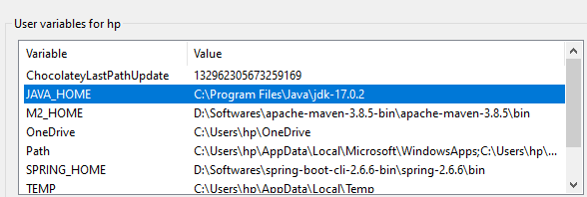
Set up

Slide 17
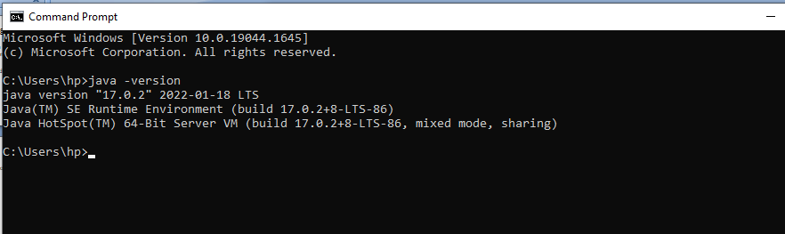
To Identify Jdk, Java compiler version

Slide 18
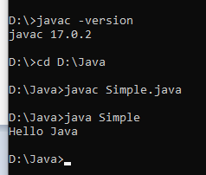
Compile the program from Terminal/Command Prompt

Slide 19
Diff ways to Initiate
public static void main(String[] args)
public static void main(String []args)
public static void main(String args[])
public static void main(String... args)
static public void main(String[] args)
public static final void main(String[] args)
final public static void main(String[] args)
final strictfp public static void main(String[] args)

Slide 20
JDK,JRE,JVM
JDK (Java Development Kit) is a Kit that provides the environment to develop and execute(run) the Java program. JDK is a kit(or package) that includes two things
Development Tools(to provide an environment to develop your java programs)
JRE (to execute your java program)
JRE (Java Runtime Environment) is an installation package that provides an environment to only run(not develop) the java program(or application)onto your machine. JRE is only used by those who only want to run Java programs that are end-users of your system.
JVM (Java Virtual Machine) is a very important part of both JDK and JRE because it is contained or inbuilt in both. Whatever Java program you run using JRE or JDK goes into JVM and JVM is responsible for executing the java program line by line, hence it is also known as an interpreter.
JIT in Java is an integral part of the JVM. It accelerates execution performance many times over the previous level

Slide 21
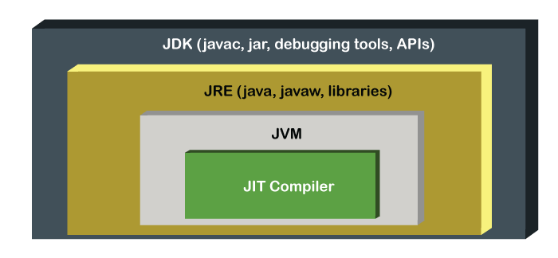

Slide 22
Install Eclipse IDE Corresponding to Java 8 Version
https://www.eclipse.org/downloads/packages/release/neon/3/eclipse-ide-java-ee-developers
Git-https://git-scm.com/
Tortoise Git -https://tortoisegit.org/download/
Sighn up an account in git-> https://github.com/

Slide 23
End Of Session 1
Thank You

